Slide 1

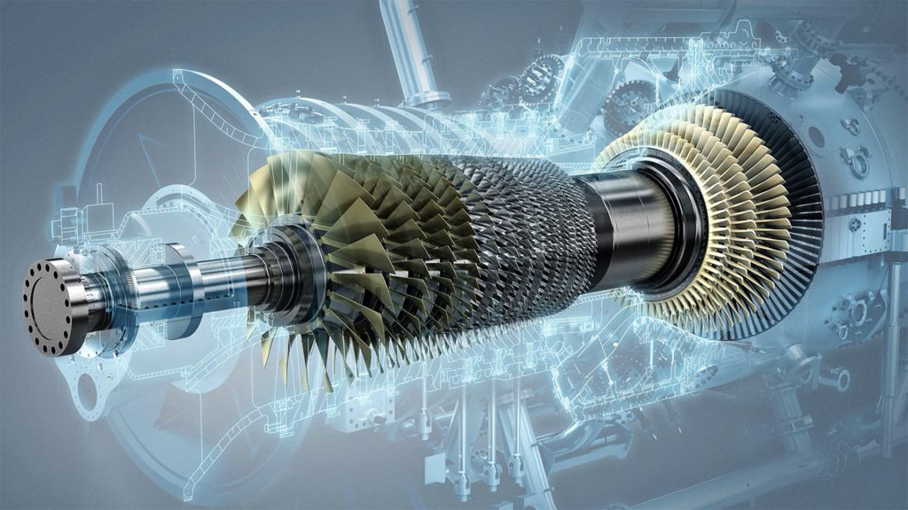

GAS TURBINE - Predicting Turbine Energy Yield (TEY)
z
PRESENTED BY
RUTUJA NARASAGOUDAR

Slide 2




RUTUJA NARASAGOUDAR
ASPIRING DATA SCIENTIST
Education
Skills
Contact
Excel
Pune, Maharashtra
PG in Data Analysis &Machine Learning
Imarticus Institute
Jul 2022 – present | Pune, India
BACHELOR OF SCIENCE
Rani Channamma University
2022 | Belgaum, India
SQL
9901314108
Statistics
Time Series
python
rutuuttu083@gmail.com
Machine Learning
Deep Learning
https://www.linkedin.com/in/rutujanarasagoudar-766b2a246/
Projects
https://github.com/RutujaNarasagoudar
IPL Dataset
In this project we have performed data cleaning, Exploratory data analysis and visualization.
.
Hobbies
Languages
English
Melbourne Housing
In this project, we handle the outliers. We apply the Linear Regression Model.
Hindi
Video
Music
Travelling
Dancing
Kannada
Turbine Energy Yeild
In this project, predicting Turbine Energy Yeild using ambient variables as features. Usage of rule based on ML models, Visualization, Explainability.
Marathi

Slide 3
AGENDA
INTRODUCTION
PROBLEM STATEMENT
ATTRIBUTE INFORMATION
EXPLORATORY DATA ANALYSIS
FEATURE SELECTION
MACHINE LEARNING ALGORITHMS
DECISION ON ALGORITHM
REPORT
CONCLUSION

Slide 4
INTRODUCTION
Instances - 36,733
Features - 11
Measures gathered over one hour , from a gas turbine located in Turkey
Predicting TEY using ambient & process variables as features

Slide 5
PROBLEM STATEMENT
Is there a relationship between the process, ambient variables & Turbine Energy Yield (TEY)
Goal is to analyze a dataset containing ambient, process and emission variables
Discover what relationships might exist between Turbine Yield Energy (TEY) & the other variables

Slide 6

ATTRIBUTE INFORMATION
TARGET COLUMN :
TEY: Turbine Energy Yield (MWH)
AMBIENT VARIABLES :
AT: Ambient temperature (C)
AP: Ambient pressure (mbar)
AH: Ambient humidity (%)
EMMISION VARIABLES :
CO: Carbon monoxide (mg/m3)
NOX: Nitrogen oxides (mg/m3)
PROCESS VARIABLES :
AFDP: Air filter difference pressure (mbar)
GTEP: Gas turbine exhaust pressure (mbar)
TIT: Turbine inlet temperature (C)
TAT: Turbine after temperature (C)
CDP: Compressor discharge pressure (mbar)

Slide 7
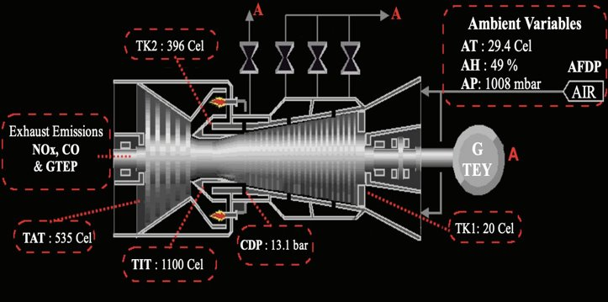
Pic 1. GAS TURBINE LAYOUT
Source : Heysem Kaya, Pinar Tufekci and Erdinc Uzun. 'Predicting CO and NOx
emissions from gas turbines: novel data and a benchmark PEMS',
Turkish Journal of Electrical Engineering & Computer Sciences, vol. 27,
2019, pp. 4783-4796,
Pic 2. WORKING OF A GAS TURBINE
Source : www.giphy.com

Slide 8
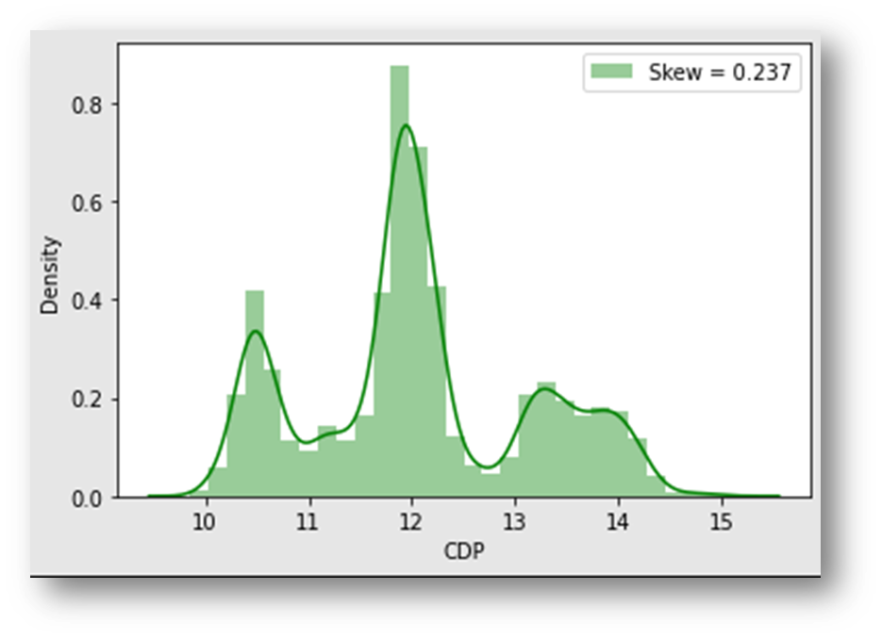
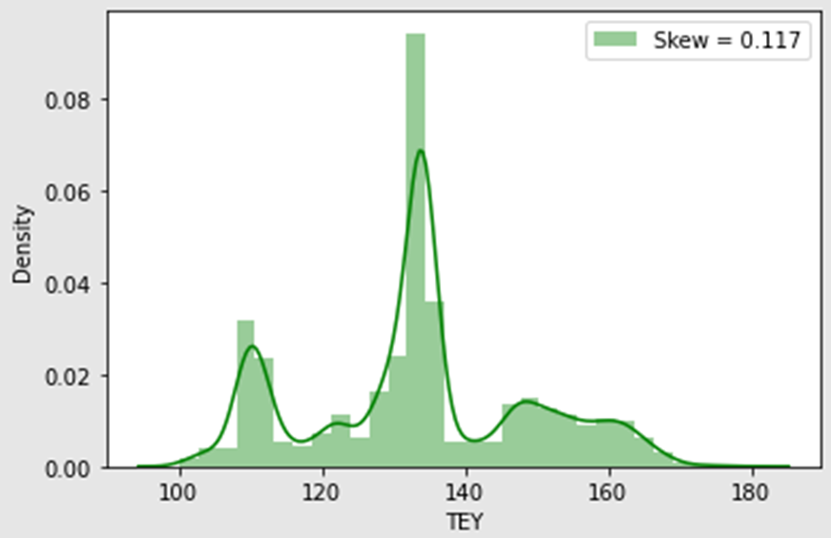
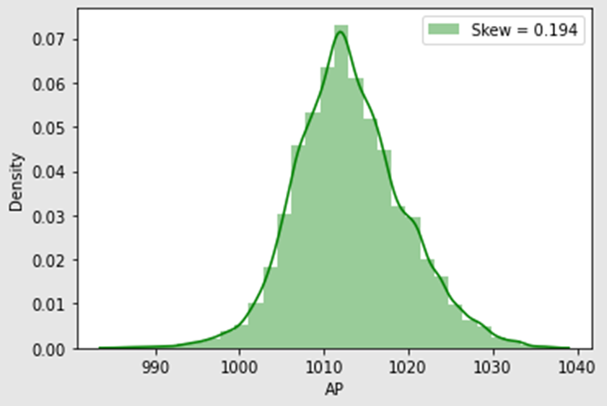
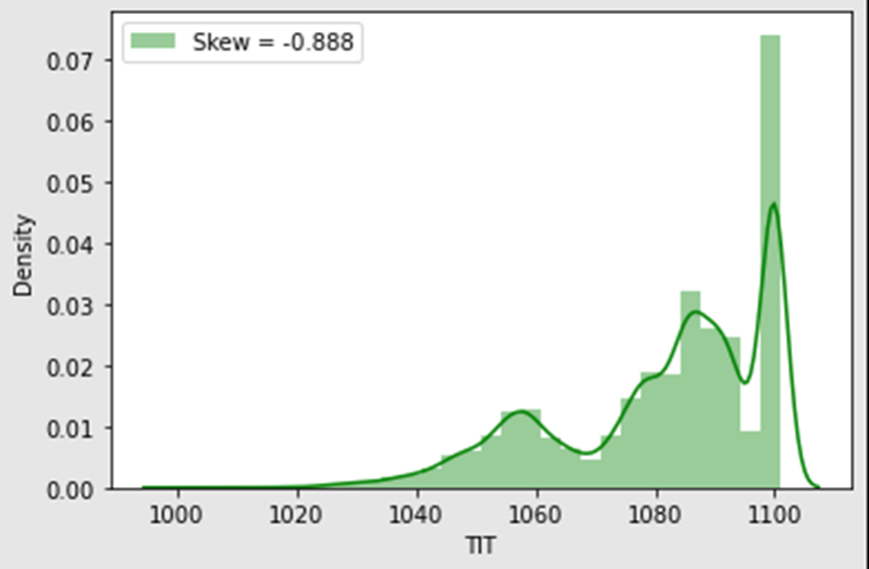
Univariate Analysis:
EXPLORATORY DATA ANALYSIS

Slide 9
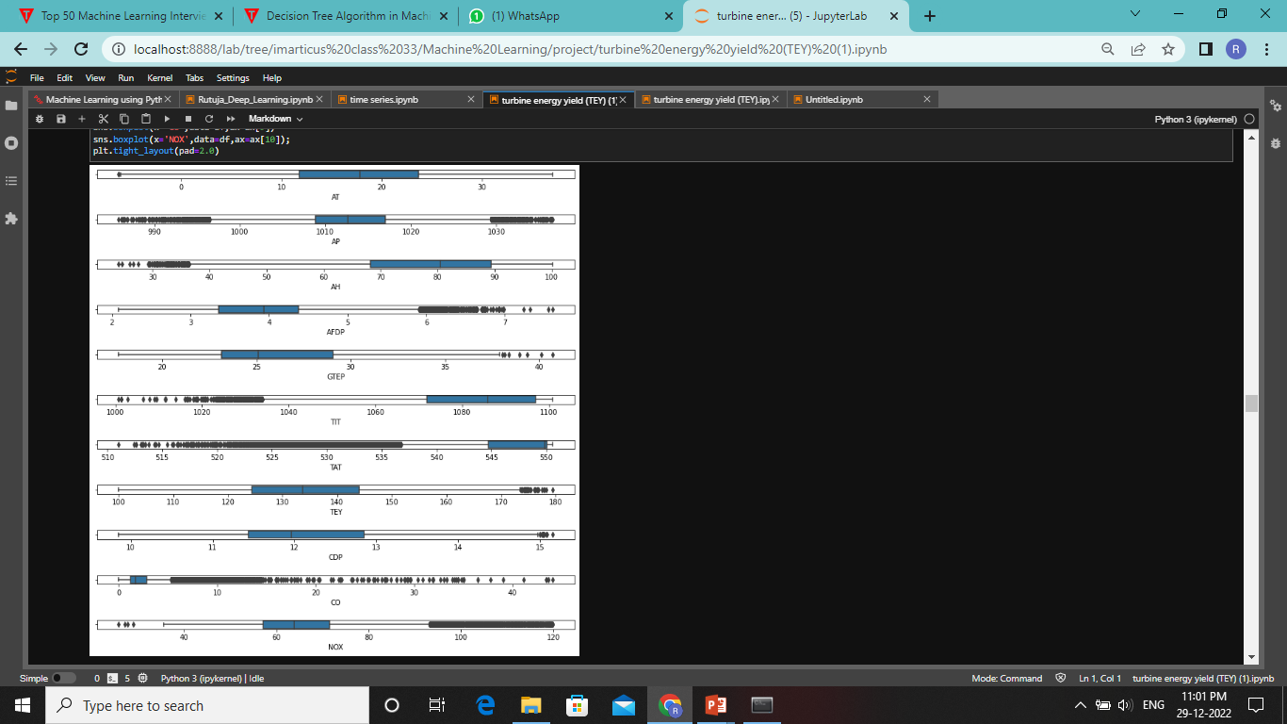
OUTLIERS

Slide 10
UNIVARIATE ANALYSIS :
Some of the features are normally distributed
The features AH, CO, TIT and TAT exhibit the highest skew coefficients
Distribution of CO and TIT and TAT seem to contain many outliers
Distplots are used to visualize the skewness of the variables

Slide 11
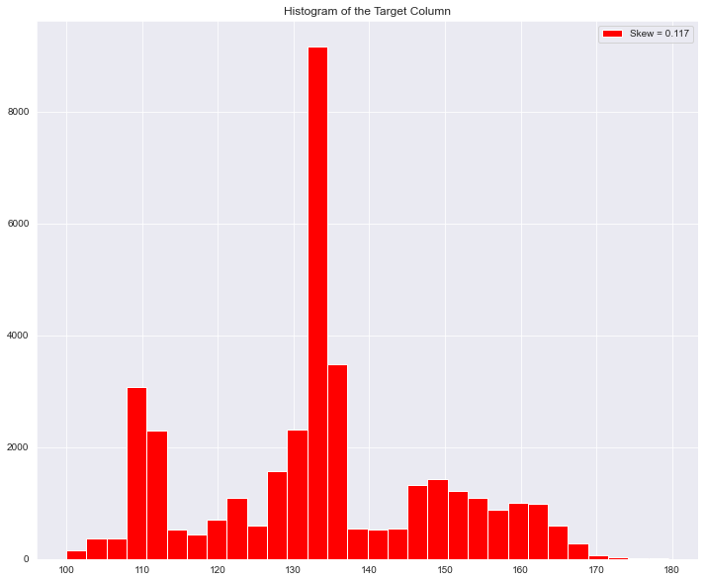
BIVARIATE ANALYSIS :

Slide 12
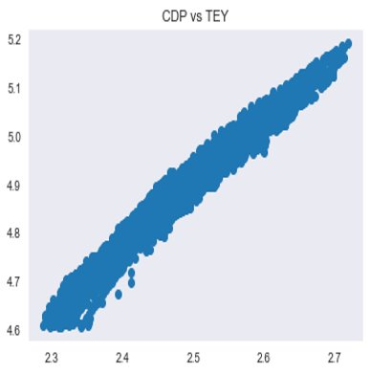
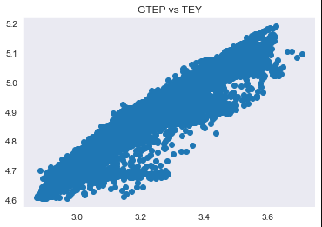

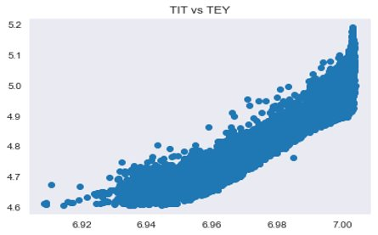
SCATTER PLOT

Slide 13
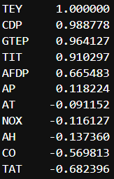
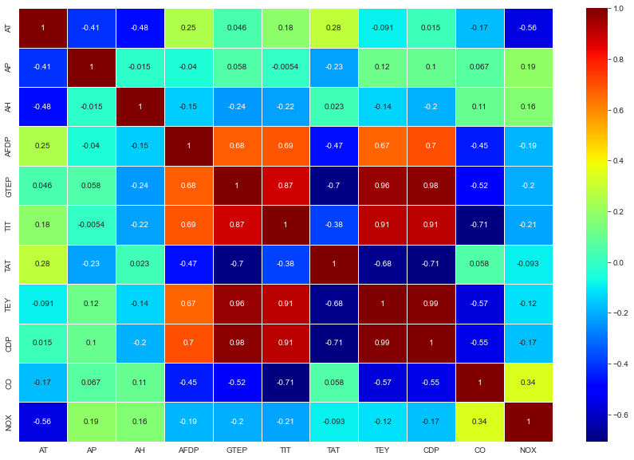
MULTIVARIATE ANALYSIS :

Slide 14
FEATURE IMPORTANCE IN DATASET
As per Univariate and Bivariate analysis CDP, GTEP, TIT, TAT, AFDP, CO these variable are very important to our prediction
In these variable there are many outliers which is directly impact our performance measure
Values of these features are highly correlated to our target columns, thus all values of features are required to get best accuracy
So we do not require to handle outliers

Slide 15
STANDARDIZATION USING STANDARD SCALER
For each feature, the Standard Scaler scales the values such that the mean is 0 and the standard deviation is 1(or the variance)
x_scaled = x – mean / std_dev
Standard Scaler assumes that the distribution of the variable is normal
Thus, in case, the variables are not normally distributed, we either choose a different scaler or first, convert the variables to a normal distribution and then apply this scaler

Slide 16
MACHINE LEARNING ALGORITHMS
SIMPLE REGRESSION 7. BAGGING
2. MULTIPLE REGRESSION 8. PASTING
3. DECISION TREE REGRESSION 9. ADABOOST
4. RANDOM FOREST REGREESION 10. GRADIENT BOOST
5. SUPPORT VECTOR REGRESSION 11. XGBOOST
6. K NEAREST NEIGHBOUR

Slide 17
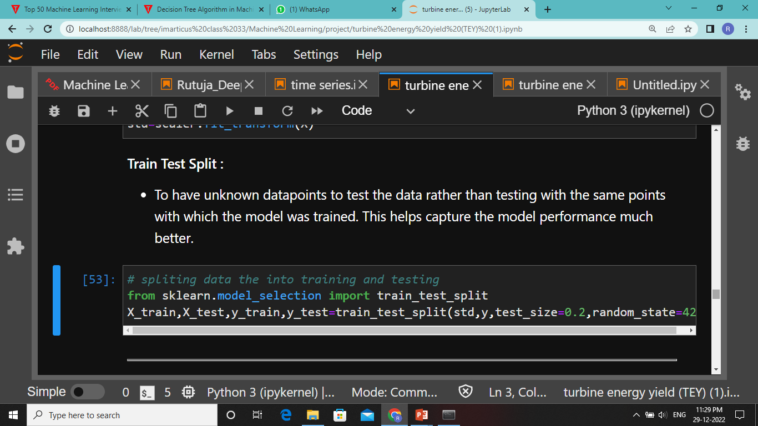
TRAIN TEST SPLIT

Slide 18
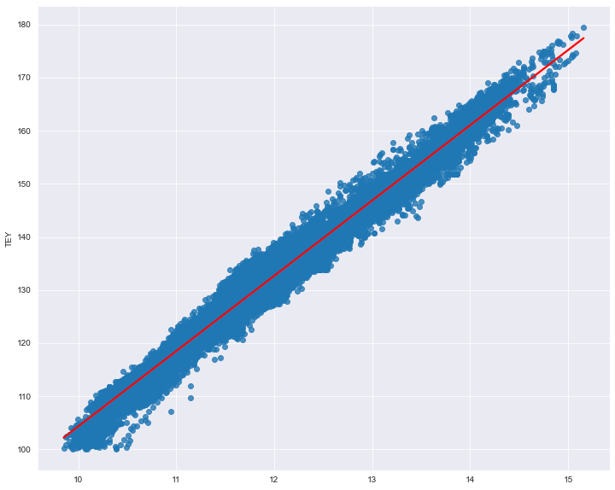
SIMPLE REGRESSION
This Simple Linear Regression Model is applied between input variable CDP (Compressor discharge pressure) & target variable TEY (Turbine Energy Yield)
PERFORMANCE
Train Result: r2_score: 0.9778
Test Result: r2_score: 0.9771
After cross validation
Training r2_score: 0.9778
Testing r2_score: 0.9771
Best Fit Line for CDP & TEY

Slide 19
MULTIPLE REGRESSION​
In Multiple Regression we use more than on independent variables are used to predict the value of dependent variable.
Independent Variables : 'CDP', 'GTEP','TIT', 'TAT', 'AFDP', 'CO', 'AT'.
Dependent variable: ’TEY’
PERFORMANCE
Train Result: r2_score: 0.995
Test Result: r2_score: 0.995
After cross validation
Training r2_score: 0.995
Testing r2_score: 0.995

Slide 20
DECISION TREE REGRESSION​​
Decision Trees a tree-structured classifier, where internal nodes represent the features of a dataset, branches represent the decision rules and each leaf node represents the outcome.
PARAMETER USED:
DTR = DecisionTreeRegressor(max_depth=2)
PERFORMANCE
Train Result: r2_score: 0.9362
Test Result: r2_score: 0.9317
After cross validation
Training r2_score: 0.9357
Testing r2_score: 0.9317

Slide 21
RANDOM FOREST REGRESSION
Random Forest contains a number of decision trees on various subsets and takes prediction from each tree and based on the majority votes of predictions it predicts the final output.
PARAMETER USED:
RFR = RandomForestRegressor(n_estimators=100)
PERFORMANCE
Train Result: r2_score: 0.999
Test Result: r2_score: 0.998
After cross validation
Training r2_score: 0.998
Testing r2_score: 0.987

Slide 22
SUPPORT VECTOR REGRESSION
Support Vector Machine is a supervised learning algorithm which can be used for regression as well as classification problems.
The main goal of SVR is to consider the maximum datapoints within the boundary lines and the hyperplane (best-fit line) must contain a maximum number of datapoints.
PERFORMANCE
Train Result: r2_score: 0.995
Test Result: r2_score: 0.995
After cross validation
Training r2_score: 0.995
Testing r2_score: 0.989

Slide 23
K NEAREST NEIGHBOUR
K-NN algorithm assumes the similarity between the new case/data and available cases and put the new case into the category that is most similar to the available categories.
PERFORMANCE
Train Result: r2_score: 0.986
Test Result: r2_score: 0.981
After cross validation
Training r2_score: 0.982
Testing r2_score: 0.981

Slide 24
BAGGING
Bagging, also known as bootstrap aggregation, is the ensemble learning method that is commonly used to reduce variance within a noisy dataset.
PARAMETERS USED :
bag_reg_Bag = BaggingRegressor(DecisionTreeRegressor(),n_estimators=500,bootstrap=True,
random_state=42)
PERFORMANCE
Train Result: r2_score: 0.999
Test Result: r2_score: 0.998
After cross validation
Training r2_score: 0.998
Testing r2_score: 0.997

Slide 25
PASTING
Pasting creates a dataset by sampling the training set without replacement.
PARAMETERS USED :
bag_reg_past = BaggingRegressor(DecisionTreeRegressor(),n_estimators=500,bootstrap=False,
random_state=42)
PERFORMANCE
Train Result: r2_score: 0.999
Test Result: r2_score: 0.998
After cross validation
Training r2_score: 0.998
Testing r2_score: 0.997

Slide 26
ADABOOST
Adoboost is a very popular boosting technique that combines multiple “weak classifiers” into a single “strong classifier”.
PARAMETERS USED :
Adaboost = AdaBoostRegressor(random_state=42)
PERFORMANCE
Train Result: r2_score: 0.984
Test Result: r2_score: 0.983
After cross validation
Training r2_score: 0.985
Testing r2_score: 0.983

Slide 27
GRADIENT BOOSTING
Gradient Boost helps us to get a predictive model in form of an ensemble of weak prediction models such as decision trees. Whenever a decision tree performs as a weak learner then the resulting algorithm is called gradient-boosted trees.
PARAMETERS USED:
grad_reg = GradientBoostingRegressor(random_state=40,learning_rate=0.1)
PERFORMANCE
Train Result: r2_score: 0.996
Test Result: r2_score: 0.996
After cross validation
Training r2_score: 0.996
Testing r2_score: 0.996

Slide 28
XGBOOST
XGBOOST is the latest version of gradient boosting which also works very similar to Gradient Boost.
PARAMETERS USED:
xgb_reg = XGBRegressor(random_state=42,learning_rate=0.1)
PERFORMANCE
Train Result: r2_score: 0.998
Test Result: r2_score: 0.997
After cross validation
Training r2_score: 0.997
Testing r2_score: 0.997

Slide 29
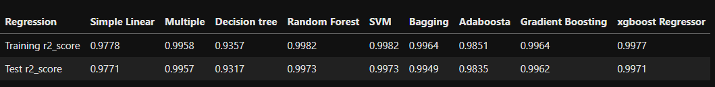
REPORT

Slide 30
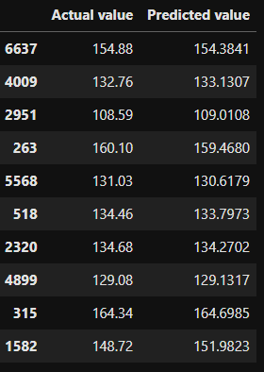
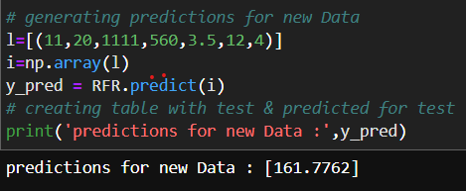
PREDICTING TARGET USING
ORIGINAL & NEW INPUTS

Slide 31
CONCLUSION
There is a relationship between the process, ambient variables 'CDP', 'GTEP','TIT', 'TAT', 'AFDP', 'CO', 'AT' and Turbine Energy Yield (TEY) also TEY can be predicted using these variables
Analyzed the dataset containing ambient, process, and emission variables from the gas turbine and discovered relationships existing between Turbine Yield Energy (TEY) and the other variables

Slide 32
THANK YOU!

